Slide 1
Chatbot for First Year Students at uOttawa
Yusri Al-Sanaani
Hetvi Soni
Tavleen Kour
Immanuella Iyawe
Group: Group: DSA_202101_ 7
Professor:
Arya Rahgozar

Slide 2
Outline
Ontology using protégé
Competency Questions
Intent Development
Chatbot design using dialog flow
Test Cases
Training questions-Responses
Evaluation
Demo
Summary

Slide 3
Ontology
Developing an ontology includes:
Defining classes.
Arranging the classes in a taxonomic (subclass–superclass) hierarchy.
Defining slots and describing allowed values for these slots.
Filling in the values for slots for instances.

Slide 4
Ontology
The competency questions:
Q1: How can I get to know my university?
Q2: Where can I find solutions for academic issues?
Q3: How to get information related to jobs and job searches?
Q4: How to get information regarding scholarships and fees?
Q5: How do I secure my rights and safety at the university?
Q6: How does the university's health insurance scheme work?

Slide 5
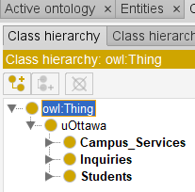
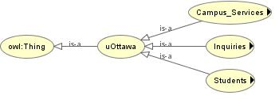
Ontology
Determine the domain and scope of the ontology:
Based on our competency questions, this ontology is for first year newly admitted students at a university to provide them answers for their most frequent questions.
The main classes:
Inquiries
Campus Services
Students
In our situation, all instances of the class Inquiries and its subclasses have slots produced from Campus Services class to Students class.

Slide 6
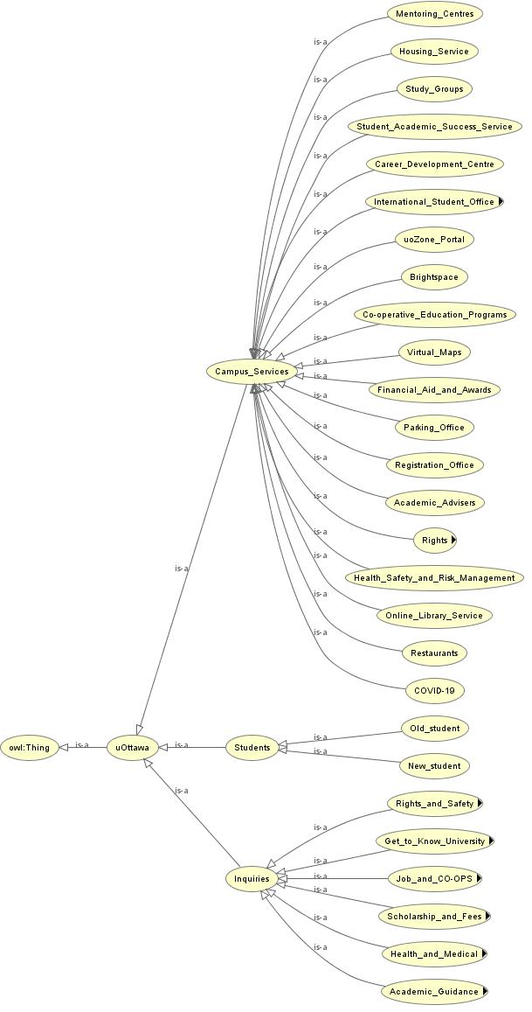
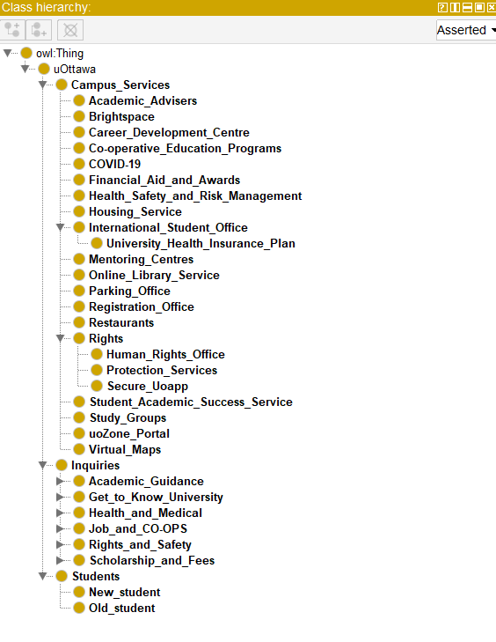
Ontology
Classes hierarchy for uOttawa, showing the campus services, students, and inquiries.

Slide 7
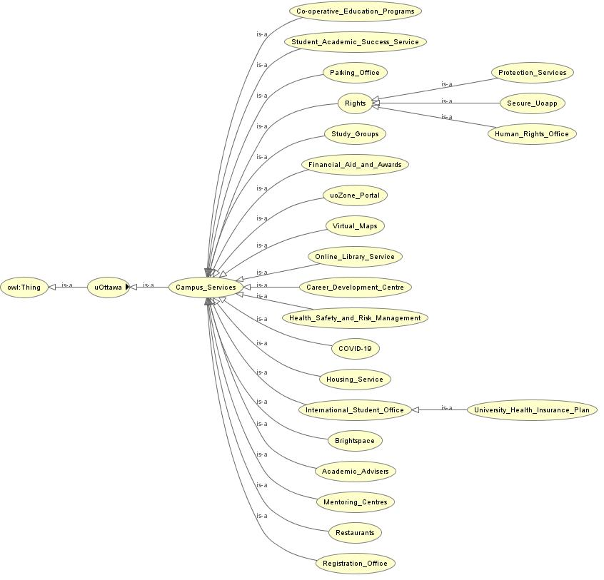
Ontology
Classes hierarchy for campus services.

Slide 8
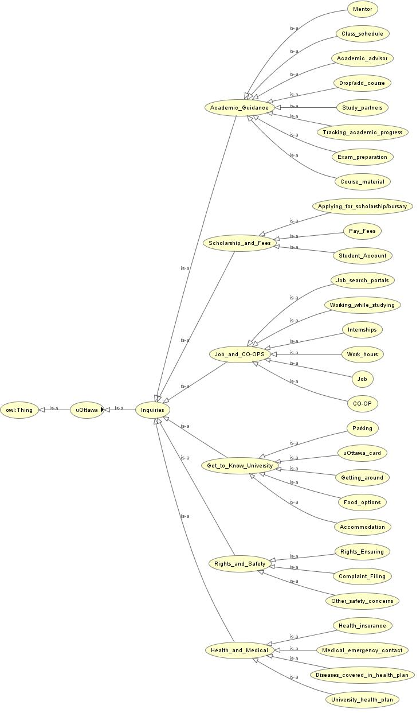
Ontology
Classes hierarchy for inquiries, showing the main topics for competency questions and their possible branches.

Slide 9
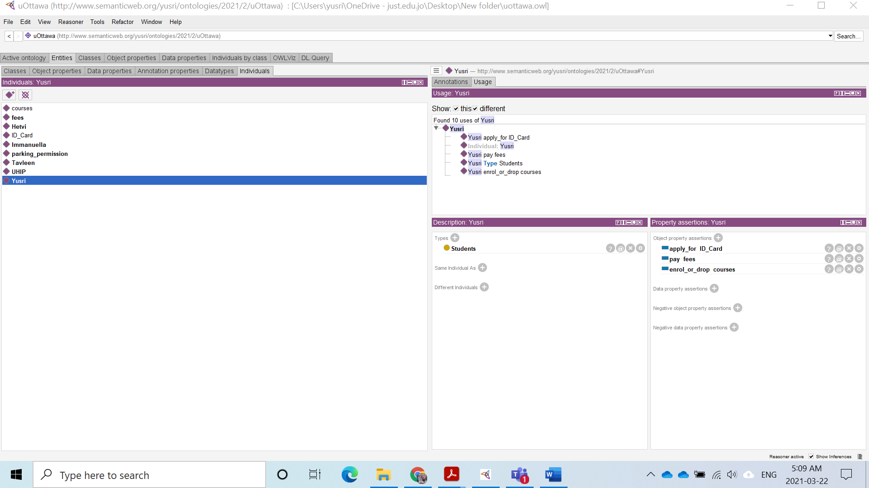
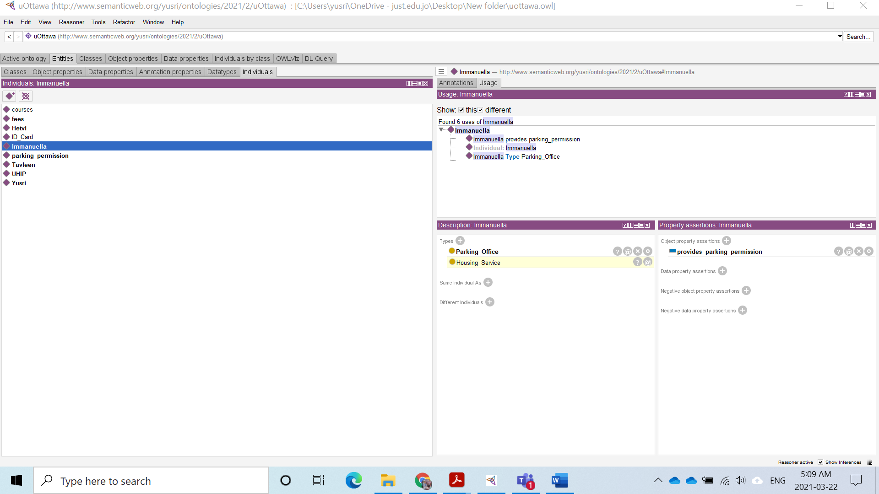
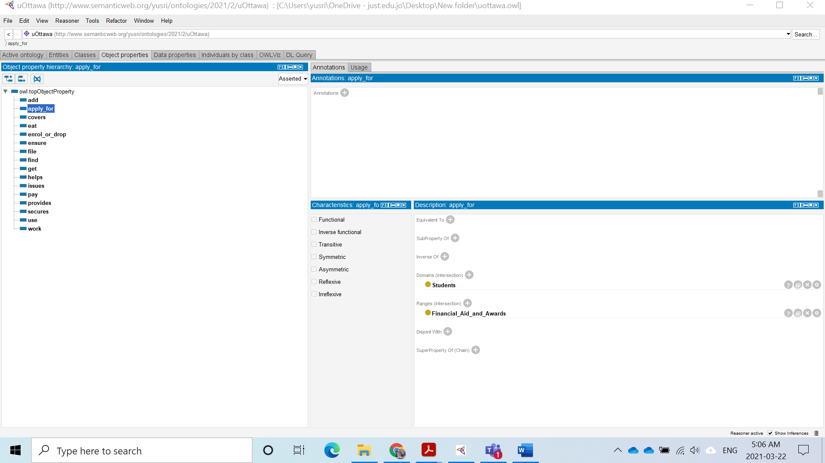
Ontology

Slide 10
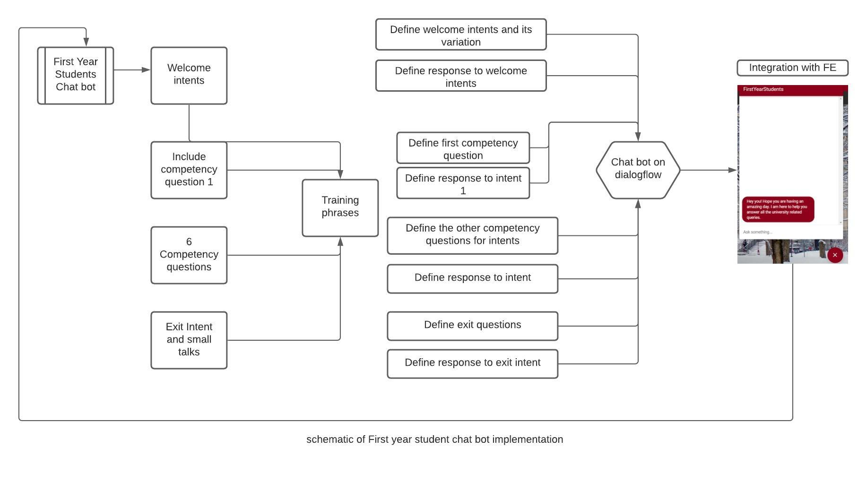
Design On DialogFlow

Slide 11
Competency Questions
Q1: How can I get to know my university?
Where can I park my bike or car on campus?
Where can I eat on campus?
Q2: Where can I find solutions for academic issues?
How can I access the study material?
How to prepare for the exams?
Q3: How to get information related to jobs and job searches?
Can I earn money while studying?
How to apply for jobs, internships?
Q4: How to get information regarding scholarships and fees?
Where can I apply for scholarships?
How to pay my fees and keep track of my student account?
Q5: How do I secure my rights and safety at the university?
How can I ensure my rights are protected?
What if I have other safety concerns?
Q6: How does the university's health insurance scheme work?
What is the medical insurance offered by the university?
Can we opt out of medical insurance?

Slide 12
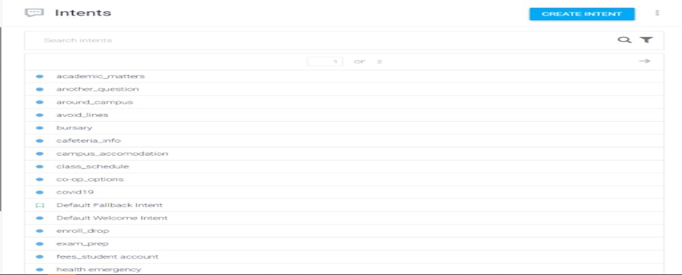
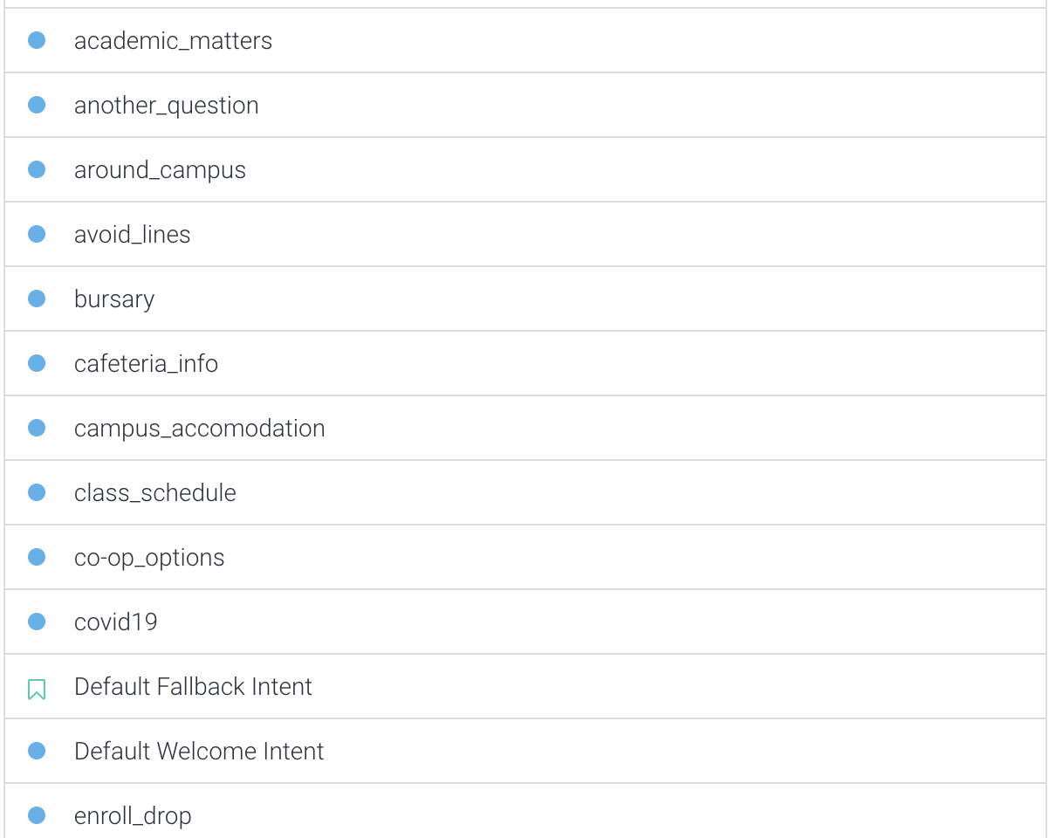
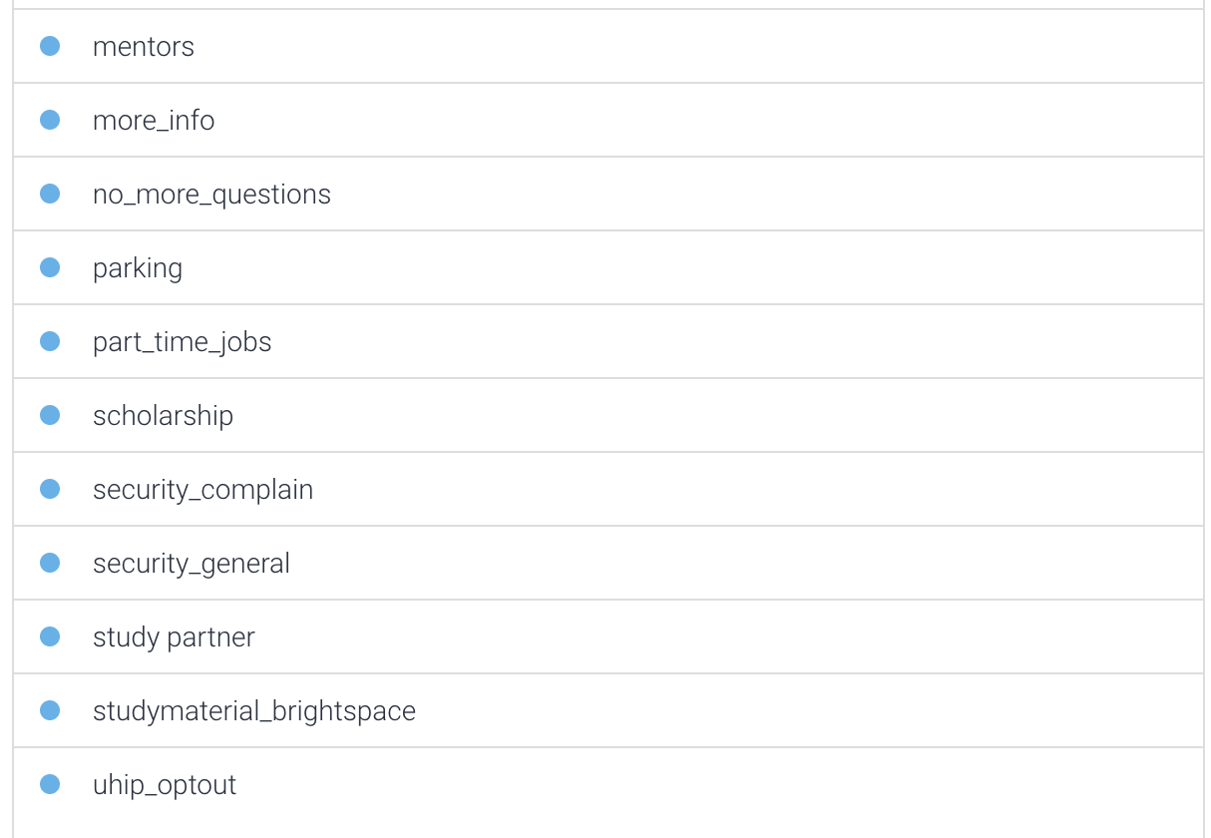
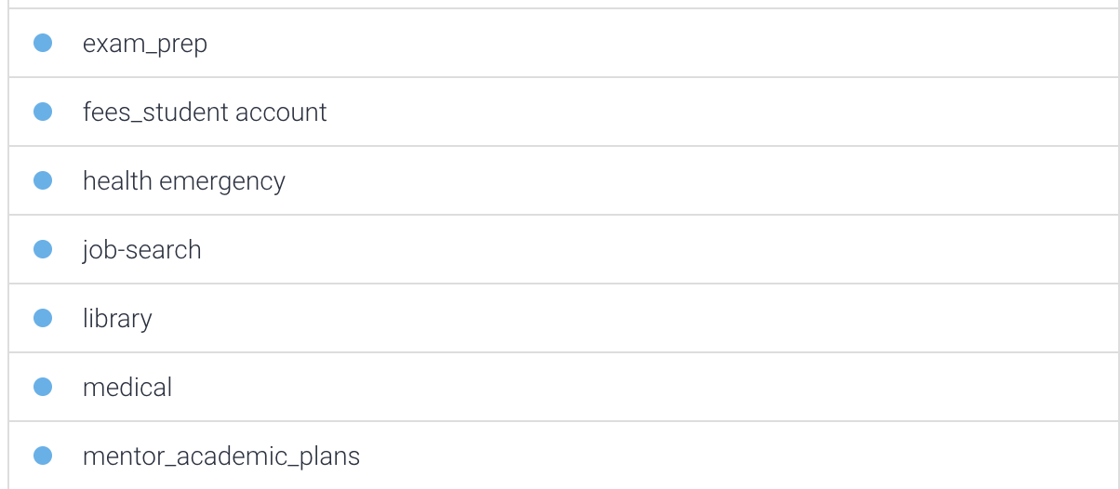
Intent Developments

Slide 13
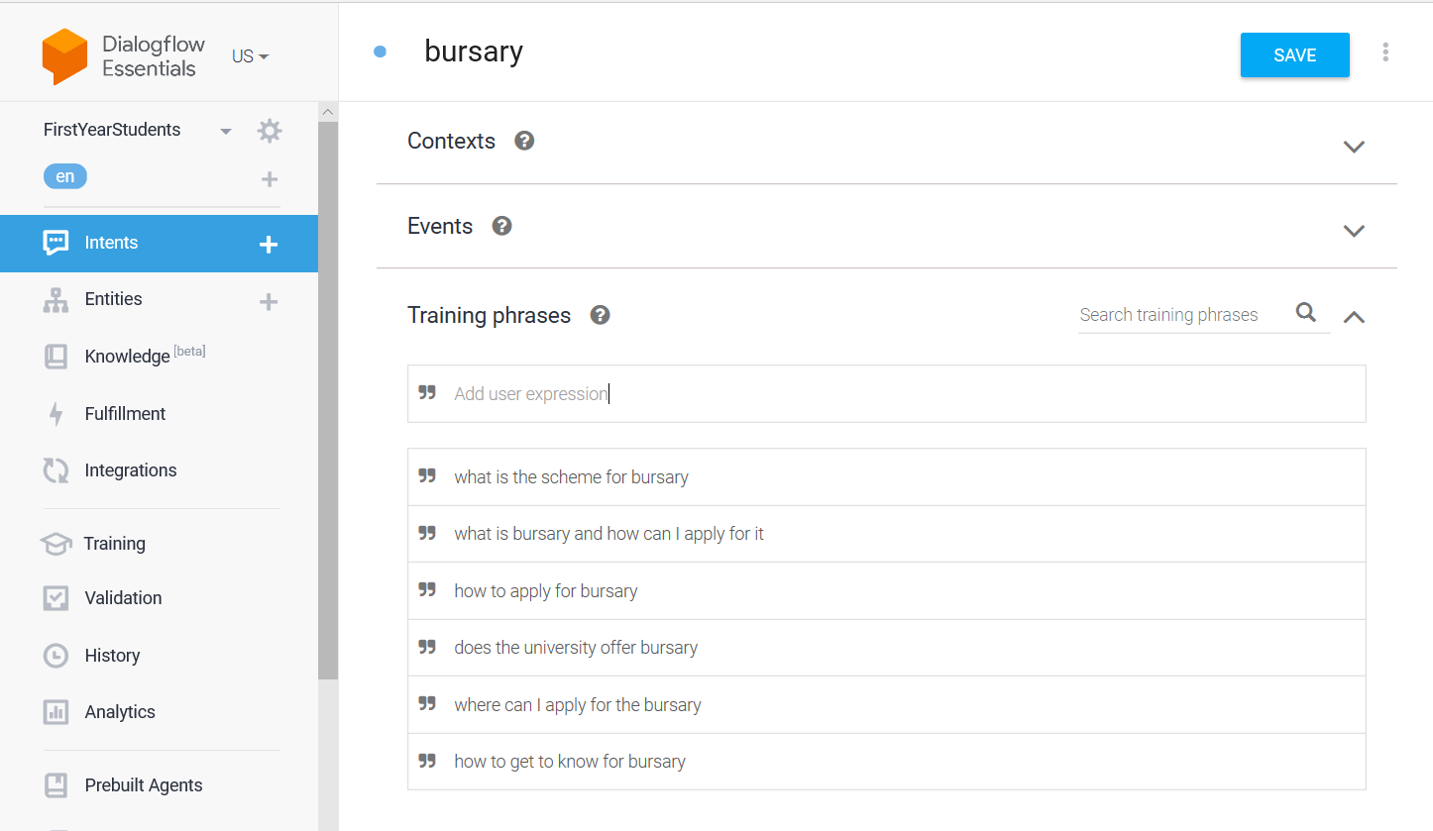
Intent Developments
Step 1
Step 2
Instance of an Intent

Slide 14
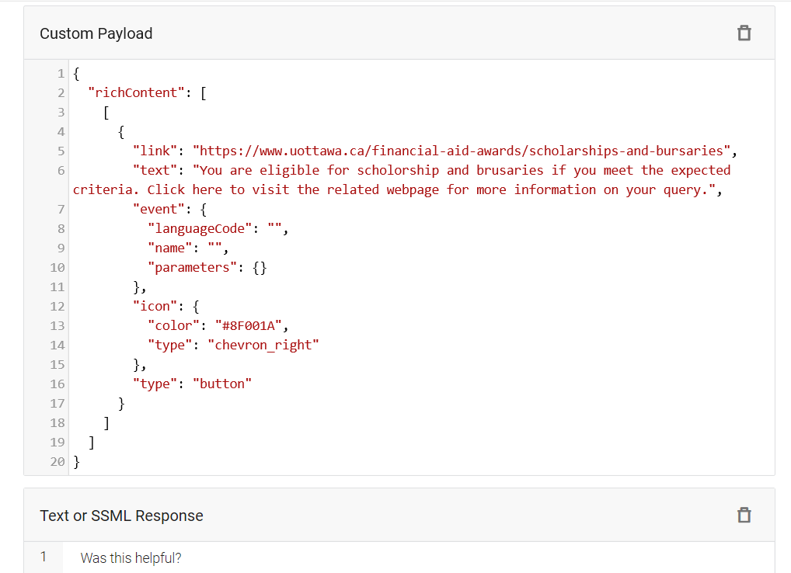
Intent Developments
Step 3
Instance of an Intent

Slide 15
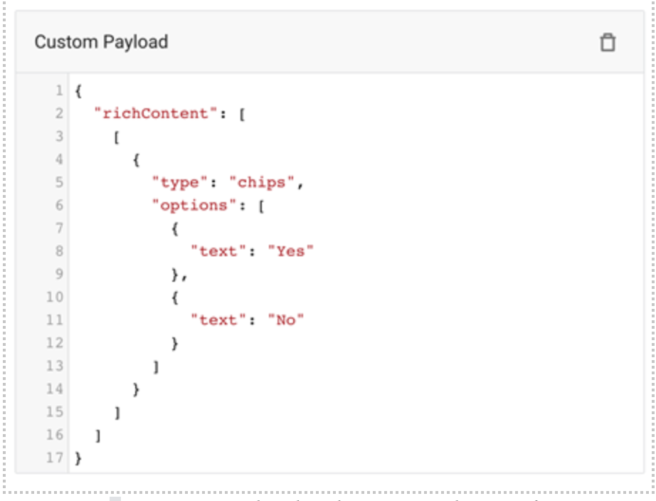
Intent Developments
Instance of a response

Slide 16
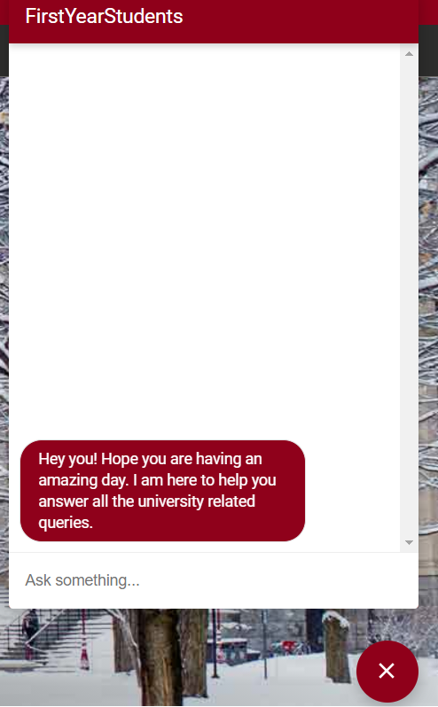
Test cases (Welcome Message)
The chatbot prompts the user with this response in order to alert the user of the chatbot feature on the uottawa website.
Chatbot Prompt: Hey you! Hope you are having an amazing day? I am here to help you answer all the university related queries.

Slide 17
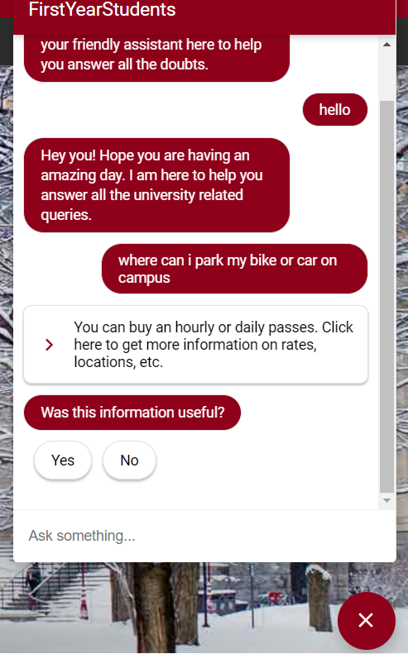
Test cases (parking)
Competency Question: How can I get to know my University?
User: Where can I park my bike or car on Campus?
Chatbot Response: You can buy an hourly or daily passes. Click here to get more information on rates, locations, etc.
It redirects the user to a helpful webpage that provides in depth information for parking on campus.

Slide 18
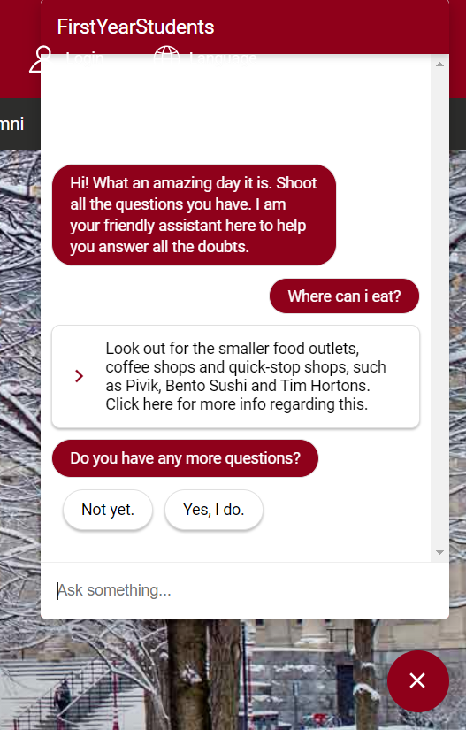
Test Cases (cafeteria_info)
Competency Question: How can I get to know my University?
User: Where can I eat on Campus?
Chatbot Prompt: Look out for the smaller food outlets, coffee shops and quick-stop shops, such as pivik, Bento Sushi and Tim Hortons. Click here for more info regarding that.

Slide 19
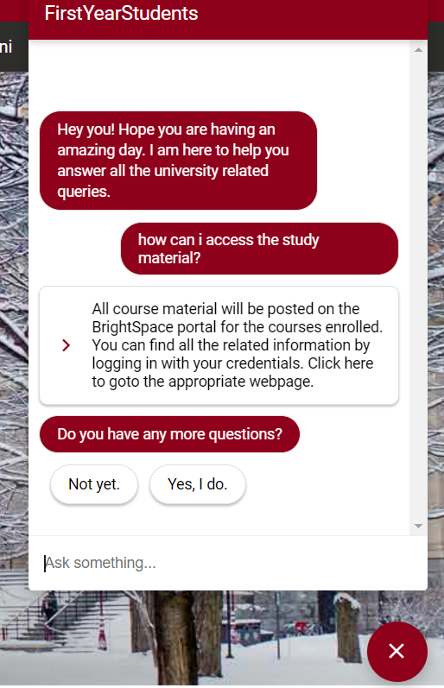
Test cases (studymaterial_brightspace)
Competency Question: Where can I find solution for academic issues?
User: How can I access the study material?
Chatbot Response: All course material will be posted on the Brightspace portal for the courses enrolled. You can find all the related information by logging in with your credentials. Click here to goto the appropriate webpage.

Slide 20
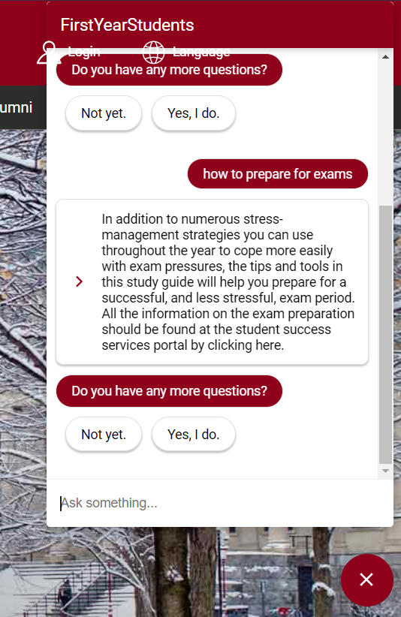
Test cases (exam_prep)
Competency Question: Where can I find solution for academic issues?
User: How to prepare for exams?
Chatbot Response: In addition to numerous stress-management strategies you can use throughout the year to cope more easily with exam pressures, the tips and tools in this study guide will help you prepare for a successful, and less stressful, exam period. All the information on the exam preparation should be found at the student success services portal by clicking here.

Slide 21
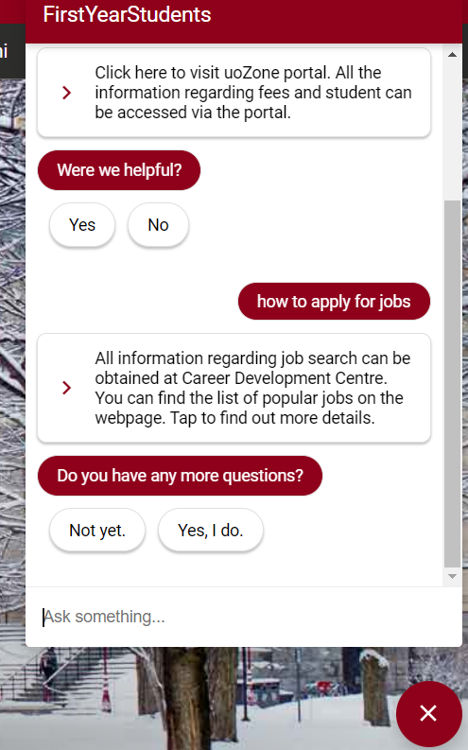
Test cases (co_op_options)
Competency Question: how to get information related to job and job searches?
User: How to apply for jobs?
Chatbot Response: All information regarding job search can be obtained at career Development center. You can find the list of popular jobs on the webpage. Tap to find out more details.

Slide 22
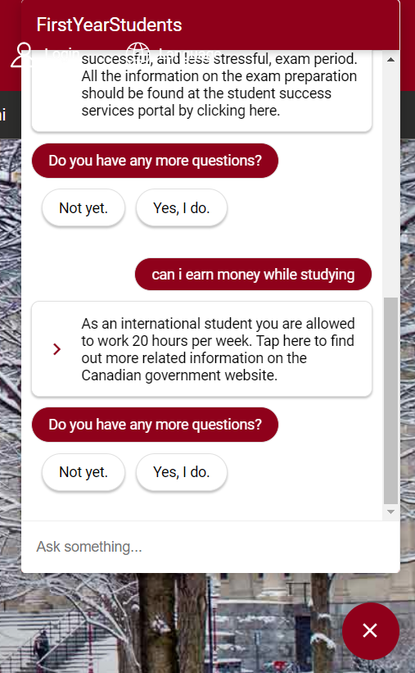
Test cases (part_time_jobs)
Competency Question: how to get information related to job and job searches?
User: Can I earn money while studying?
Chatbot Response: As an international student you are allowed to work 20hours per week. Tap here to find out more related information on the Canadian government website.

Slide 23
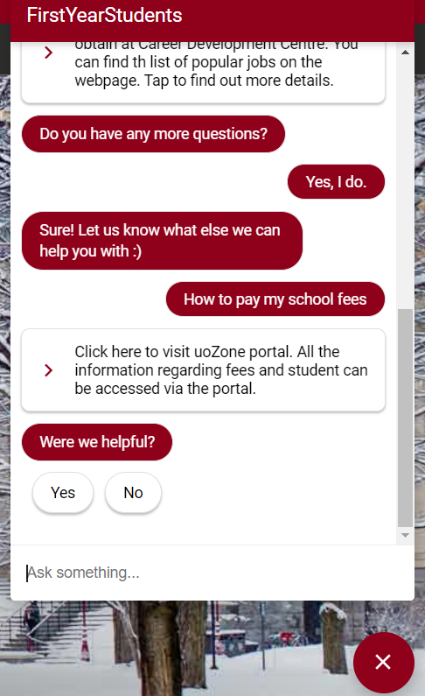
Test cases (fees_student account)
Competency Question: How to get information regarding scholarship and fees?
User: How to pay my fees and keep track of student account?
Chatbot Response: Click here to visit uoZone portal. All the information regarding fees and student can be accessed via the portal.

Slide 24
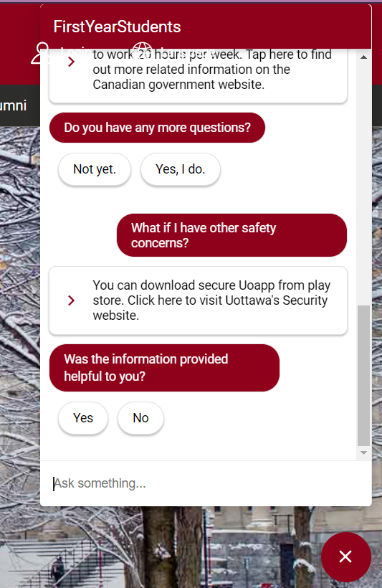
Test cases (security_general)
Competency Question: How do I secure my rights and safety at the University?
User: What if I have other safety concerns?
Chatbot Response: You can download secure Uoapp from play store. Click here to visit Uottawa’s Security website.

Slide 25
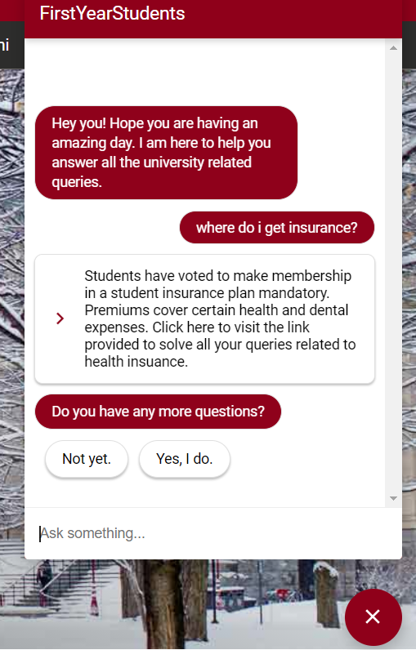
Test cases (medical)
Competency Question: How does the University health insurance work?
User: Where do I get insurance?
Chatbot Response: Students have voted to make membership in a student insurance plan mandatory. Premiums cover certain health and dental expenses. Click here to visit the link provided to solve all your queries related to health insurance.

Slide 26
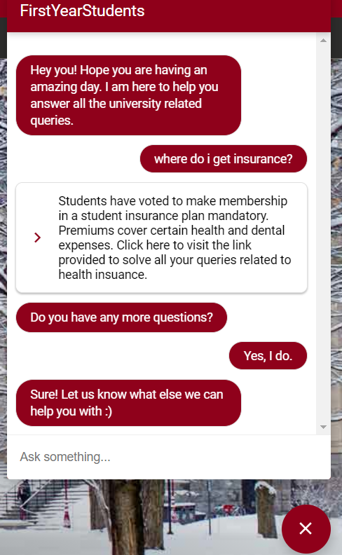
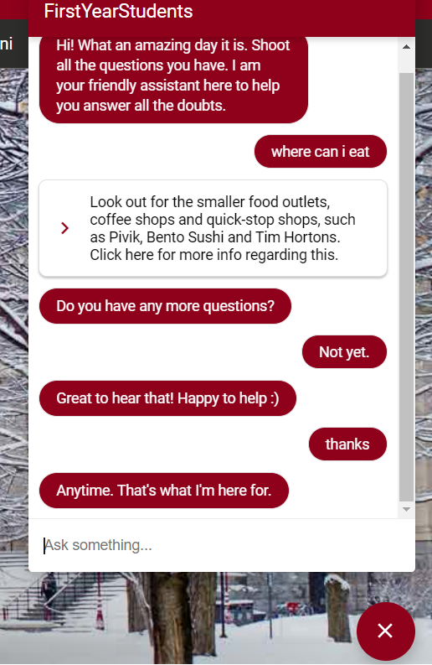
Test cases

Slide 27
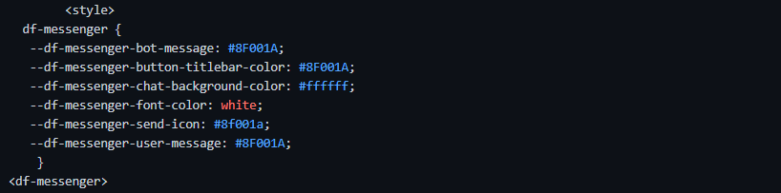
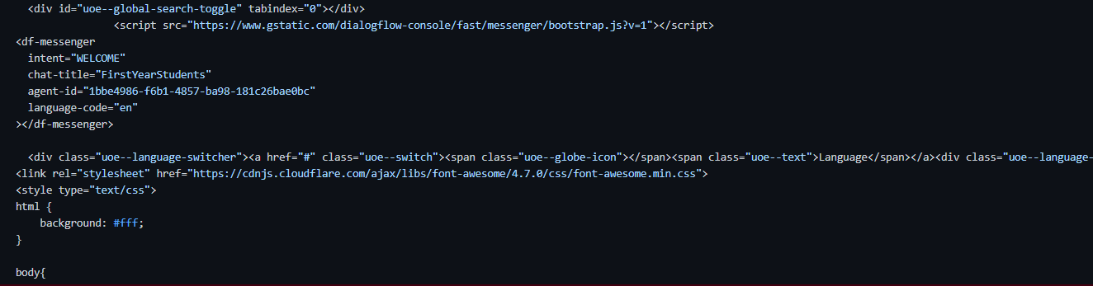
Implementation on Uottawa webpage

Slide 28
Demo
https://sonihetvi10.github.io/ChatBot_Uottawa.github.io/

Slide 29
Weaknesses
There is no way to add a hyperlink in the text. The workaround we implemented is to add a button and assign it to a link.
We found a small bug that we are not allowed to change the letter case of the intent names, because the text field is not case-sensitive and we see an error saying that the name already exists. The workaround we implemented is to change the name to a new name and then rename it later to the intended name again with the correct letter case.
Due to time limitation constraints, we were unable to implement a case specific solution for the queries posted in the Chatbot.
We didn't collect user information(store in database), which would help the user file a complaint and provide the user with a ticket and later respond to the user with the information they are looking for.
We’re unable to add intents/questions regarding international student queries due to time constraint it requires multiple cases to be taken into consideration.

Slide 30
Summary
In conclusion, the chatbot aims to solve issues first year students will have while trying to get accustomed to the university.
We implemented this chatbot by providing uOttawa website as an external web page hence the different user interface.
Costume payloader have been used to include clickable links and rich texts.
Naturally dialogflow chatbot although allows for integration with popular channels, does not have a flow in a conversation hence there is limitation in error avoidance.

Slide 31
Thanks

